Slide 1
Backtracking Methodology & its Applications

Slide 2
Contents
Backtracking
N-Queen problem
Subset-sum problem
Hamiltonian-cycle
Graph-coloring
Graph-coloring using Intelligent Backtracking
Conclusion

Slide 3
BACKTRACKING
The principle idea of back-tracking is to construct solutions as component at a time. And then evaluate such partially constructed solutions.

Slide 4
Backtracking [animation]
dead end
?
dead end
dead end
?
start
?
?
dead end
dead end
?
success!

Slide 5
Key Terms:
State-space tree
Root
Components
Promising & Non-promising
Leaves

Slide 6
N-Queen Problem
Problem:-
The problem is to place n queens on an n-by-n chessboard so that no two queens attack each other by being in the same row, or in the same column, or in the same diagonal.
Observation:-
Case 1 : n=1
Case 2 : n=2
Case 3 : n=3
Case 4 : n=4

Slide 7
Case 4: For example to explain the n-Queen problem we Consider n=4 using a 4-by-4 chessboard where 4-Queens have to be placed in such a way so that no two queen can attack each other.
1
2
3
4
1
2
3
4

Slide 8
0
Q
 | Q
5
1
x
x
x
x
x
Q
 |  | Q
Q
 |  |  | Q
 | Q
 |  |  | Q
2
3
6
x
x
x
x
Q
 |  |  | Q
 | Q
x
x
 | Q
 |  |  | Q
Q
4
7
x
x
x
x
x
x
 | Q
 |  |  | Q
Q
 |  | Q
8

Slide 9
Using this above mechanism we can obtain two solutions shown in the two consecutive figures:-
1
2
3
4
 | Q
 |  |  | Q
Q
 |  | Q
1
Queen-1
2
Queen-2
3
Queen-3
4
Queen-4
Figure:-
Board for the four-queens problem

Slide 10
1
2
3
4
 |  | Q
Q
 |  |  | Q
 | Q
1
Queen-1
2
Queen-2
3
Queen-3
4
Queen-4
Figure:-
Board for the four-queens problem

Slide 11
Subset-sum Problem
Subset-sum Problem:
The problem is to find a subset of a given set S = {s_{1,} s₂,- - -, s_{n}} of ‘n’ positive integers whose sum is equal to a given positive integer ‘d’.
Observation :
It is convenient to sort the set’s elements in increasing order, S₁ ≤ S₂ ≤ ….. ≤ S_{n.} And each set of solutions don’t need to be necessarily of fixed size.
Example :
For S = {3, 5, 6, 7} and d = 15, the solution is shown below :-
Solution = {3, 5, 7}

Slide 12
0
0
with 3
w/o 3
3
3
0
with 5
w/o 5
with 5
w/o 5
8
3
5
0
5
with 6
w/o 6
with 6
w/o 6
with 6
w/o 6
0+6+7<15
x
14
8
9
3
11
5
6
14+7>15
with 7
w/o 7
9+7>15
3+7<15
11+7>15
5+7<15
x
x
x
x
x
7
15
8
solution
8<15
x
Figure :
Compete state-space tree of the backtracking algorithm applied to the instance S = {3, 5, 6, 7} and d = 15 of the subset-sum problem. The number inside a node is the sum of the elements already included in subsets represented by the node. The inequality below a leaf indicates the reason for its termination.

Slide 13
Hamiltonian Circuit Problem
Problem:
This problem is concern about finding a Hamiltonian circuit in a given graph.
Hamiltonian circuit:
Hamiltonian circuit is defined as a cycle that passes to all the vertices of the graph exactly once except the starting and ending vertices that is the same vertex.

Slide 14
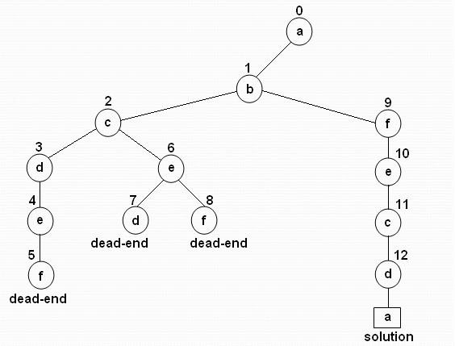
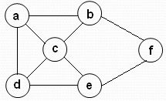
For example consider the given graph and evaluate the mechanism:-
(a)
(b)
Figure:
(a) Graph.
(b) State-space tree for finding a Hamiltonian circuit. The numbers above the nodes of the tree indicate the order the order in which nodes are generated.

Slide 15
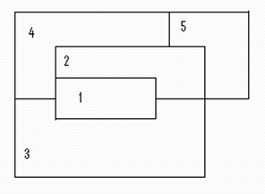
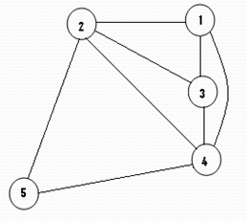
Coloring a map
Problem:
Let G be a graph and m be a given positive integer. We want to discover whether the nodes of G can be colored in such a way that no two adjacent node have the same color yet only m colors are used. This technique is broadly used in “map-coloring”; Four-color map is the main objective.
Consider the following map and it can be easily decomposed into the following planner graph beside it :

Slide 16
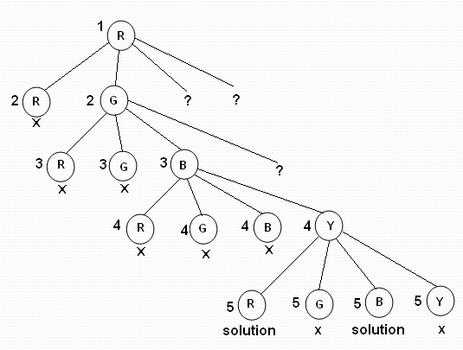
This map-coloring problem of the given map can be solved from the planner graph, using the mechanism of backtracking. The state-space tree for this above map is shown below:

Slide 17
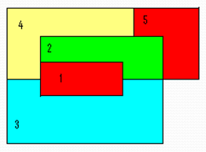

Now the map can be colored as shown here:-
Four colors are chosen as - Red, Green, Blue and Yellow

Slide 18

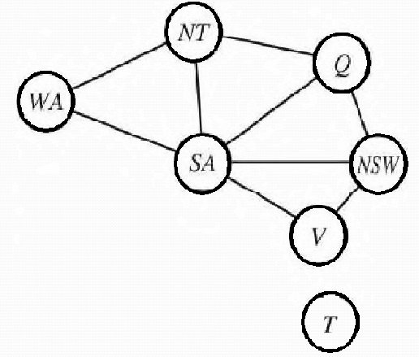
Artificial Intelligence
Figure:
(a) The principal states and territories of Australia. Coloring this map can
be viewed as a constraint satisfaction problem (CSP). The goal is to assign colors to each region so that no neighboring regions have the same color. (b) The map-coloring problem represented as a constraint graph.

Slide 19
Problem:
We are given the task of coloring each region either red, green, or blue in such a way that no neighboring regions have the same color. To formulate this as a CSP the following assumptions are made:
regions as, X = {WA, NT ,Q, NSW ,V,SA,T}
domain of each variable Di = {red, green, blue}
Constraints: C = {SA WA, SA NT, SA Q, SA NSW, SA V, WA NT, NT Q, Q NSW , NSW V}

Slide 20
Observation:-
Once we have chosen {SA = blue}, none of the five neighboring variables can take on the value blue. So we have only 2⁵ = 32 assignments to look at instead of 3⁵= 243 assignments for the five neighboring variables.
Furthermore, we can see why the assignment is not a solution—we see which variables violate a constraint—so we can focus attention on the variables that matter.

Slide 21
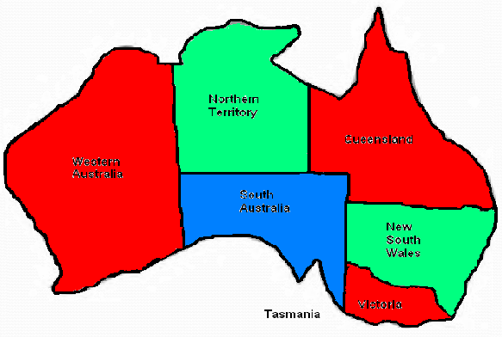
Now the map can be colored as shown here:-

Slide 22
Conclusion
In conclusion, three things on behalf of backtracking need to be said:-
It is typically applied to difficult combinatorial problems for which no efficient algorithm for finding, exact solutions possibly exist.
Backtracking solves each instances of a problem in an acceptable amount of time.
It generates all elements of the problem state.

Slide 23
Reference:
Books:
Anany Levitin Design and Analysis of Algorithms (page 394-405)
Computer Algorithms Horowitz and Sahani (page 380-393)
http://www.2shared.com/document/W1dBNIGP/Stuart_Russell_and_Peter_Norvi.html

Slide 24
Thank You

